Slide 1
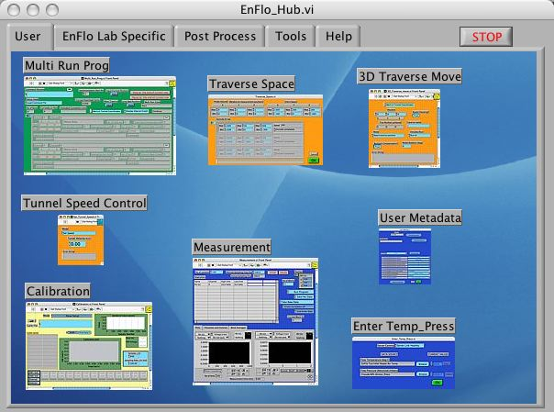
Taking data in the EnFlo lab

Slide 2
Instrumentation available
Pitot tubes
Micromanometers
Ultra sonic anemometers
Hot wire anemometry (single and cross)
LDA (2 Component)
4 Fast response Flame ionisation detectors
Heat Flux using LDA and cold wire (ut, wt)
Conc Flux using LDA and FFID (uc , wc)
Thermocouples
48 port Scani valve (pressure tappings)
Pulsed wire (Not currently part of software)

Slide 3
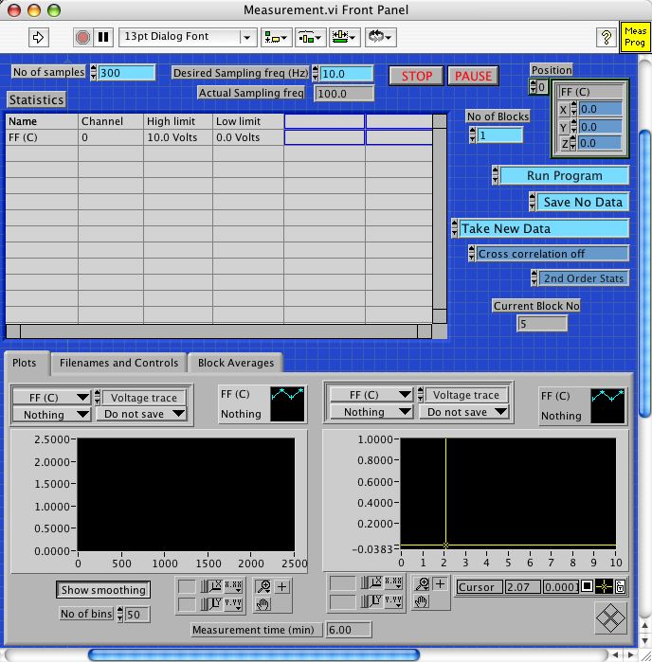
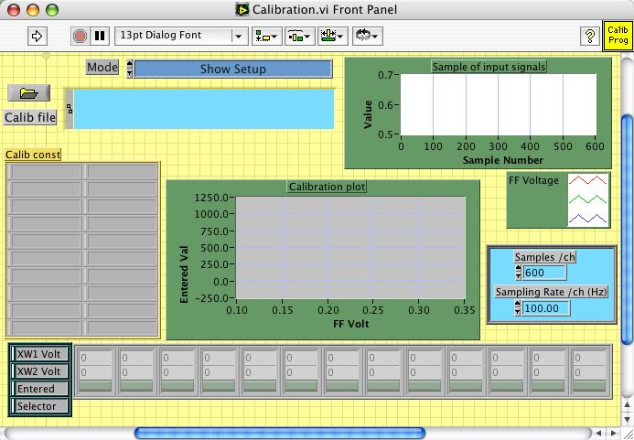

EnFlo Software
EnFlo_Hub.vi
Written in LabVIEW

Slide 4

Acquisition Loop
Read block of Binary Data
Measurement.vi
Write binary data to raw data file
Convert to voltages
Sets Acquisition in Progress
Apply Calibration
Acquisition Loop
For number of blocks
Calculate statistics
Run any user plugins
Get Server Channel averages
Update front panel
Append row to results file
End
Live demo

Slide 5
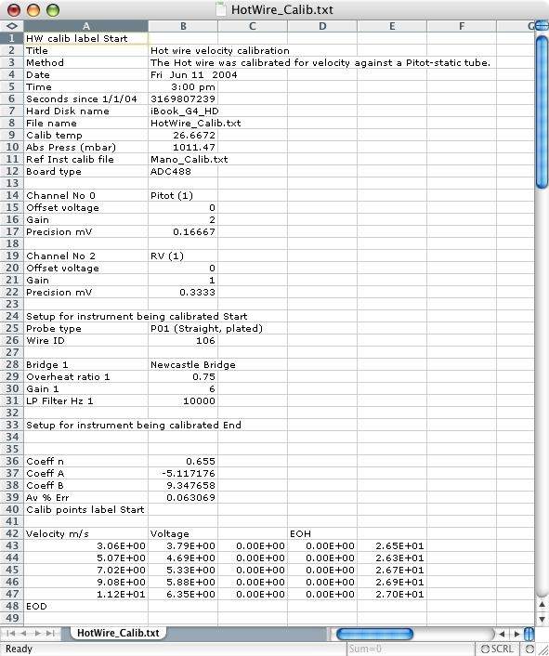
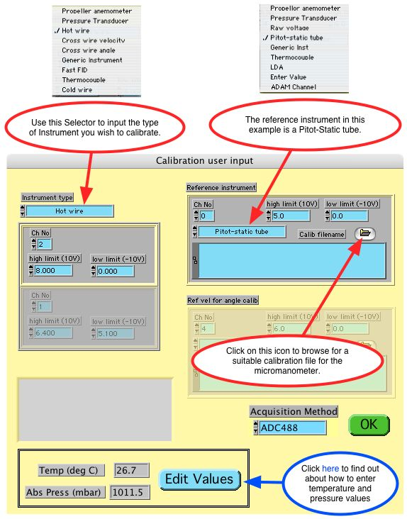
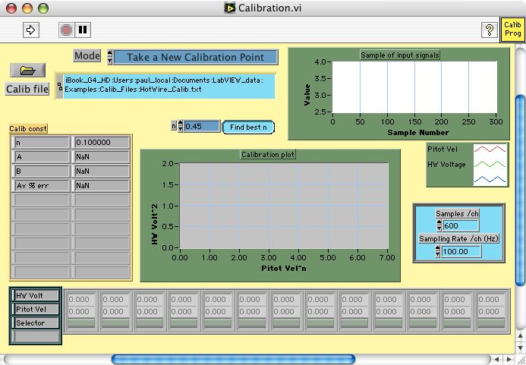
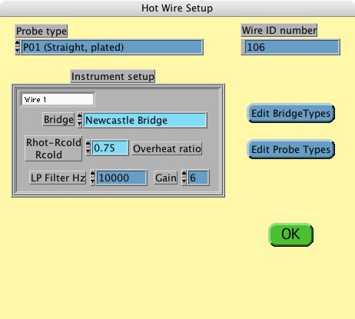
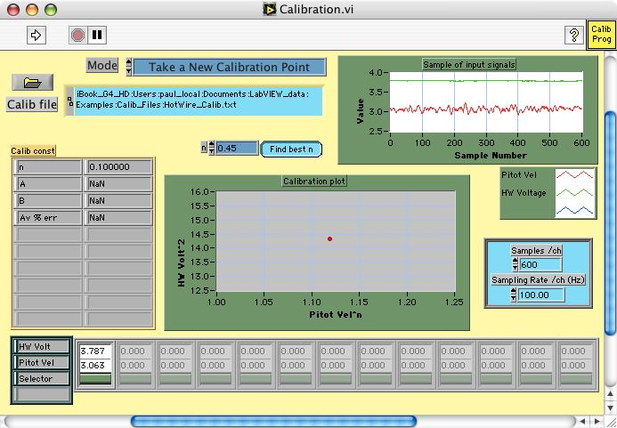
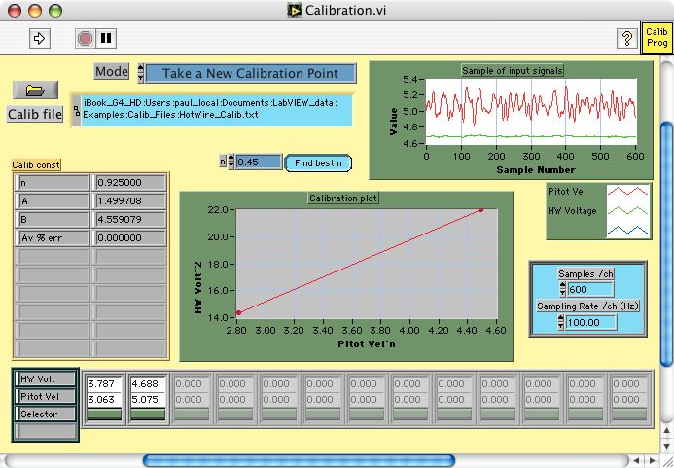
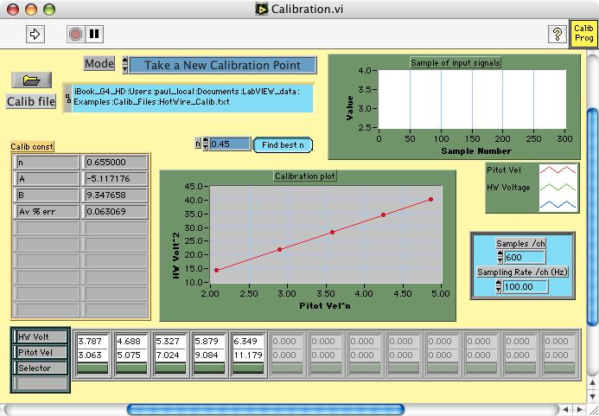
Calibration.vi
Show Setup
Set Tunnel speed
Choose:
Instrument type to Calibrate
Reference Instrument
Acquire data using
Measurement.vi
Saves a calibration file
Containing all setup information
Calculate Coefficients
Display Fit
Save Calibration file
End

Slide 6
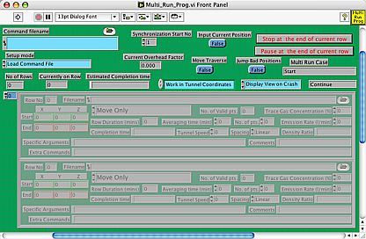
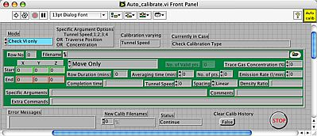
Auto_calibrate.vi
Multi_Run_Prog.vi
Tunnel speeds
2; 4; 6; 8;
Autocalibrate Hot wire
Set Traverse Position
Set tunnel speed
Vertical profile 1
Take next Calibration Point
Vertical profile 2
Autocalibrate Hot wire
Check Quality of Calib Fit (Email)
Calculate Drift since last Calib (Email)
Set Tunnel speed to zero
Update Appropriate Results files

Slide 7
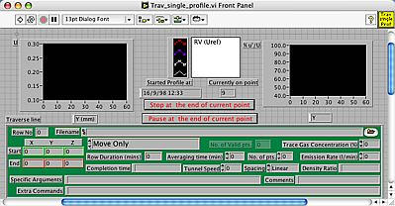
Trav_single_profile.vi
Multi_Run_Prog.vi
From:
Start and End Postions
Number of Points
Spacing Log/Linear
Autocalibrate Hot wire
Calculate Array of Positions
Vertical profile 1
Vertical profile 2
Set tunnel speed
Autocalibrate Hot wire
Set Traverse Position
Set Tunnel speed to zero
Run Measurement Program

Slide 8
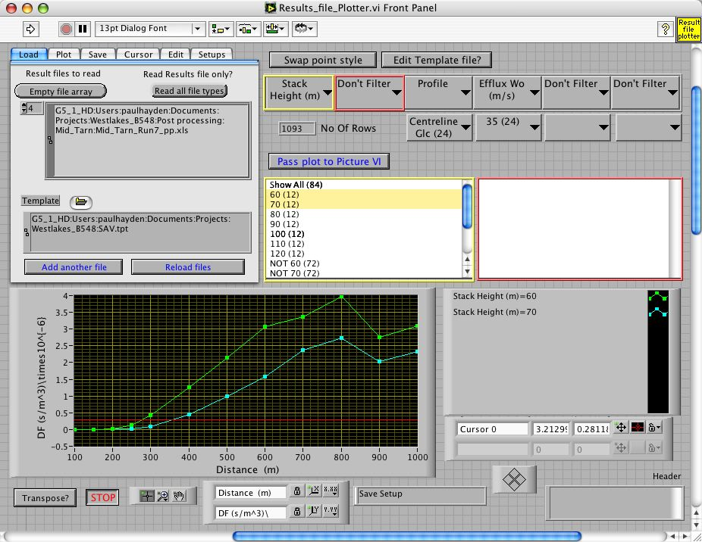
Results_file_plotter.vi

Slide 9
Some problems code emails on
Input voltage out of range of ADC
Instrument clipping
Poor calibration fit
(FFID only), Stability of calibration point
Calibration Drift
Tunnel inlet screens blocking up (Beware!!)
Errors in chilled water temp
Traverse errors

Slide 10
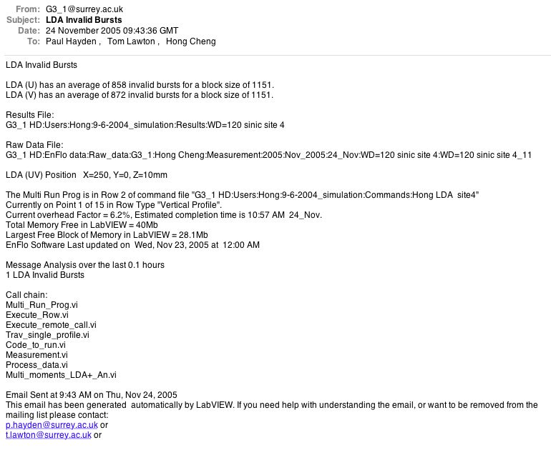
Example Error Email

Slide 11
Pick up errors ASAP
Do not change wind tunnel configuration without having had a good look at the data you have taken
Calculate final quantities straight away if possible
Generally easy to repeat run straight away - but a lot of work later

Slide 12
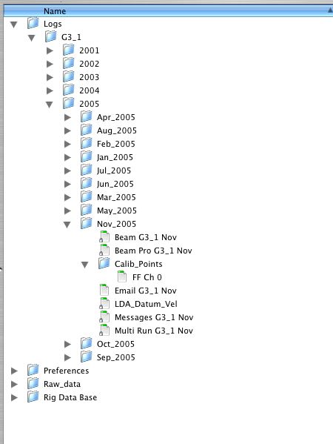
Log files
Messages
Emails tried to send
Calibration points
Multi Run rows executed
LDA datum power
LDA datum velocity
Traverse positions
Traverse space files
Server day files

Slide 13
Is your data repeatable?
Code now calculates standard error
σ = Standard deviation of time trace
N= number of independent samples
T_{total} = total measurement time at location
T₀ = Autocorrelation time to first zero crossing point

Slide 14
Post Processing
Fast Flame Ionisation Detector background and calibration drift correction.
Output time traces in ASCII format
Higher order moments
Apply correction routines (Tutu and Chevray)
Run user specific Plug-ins

Slide 15
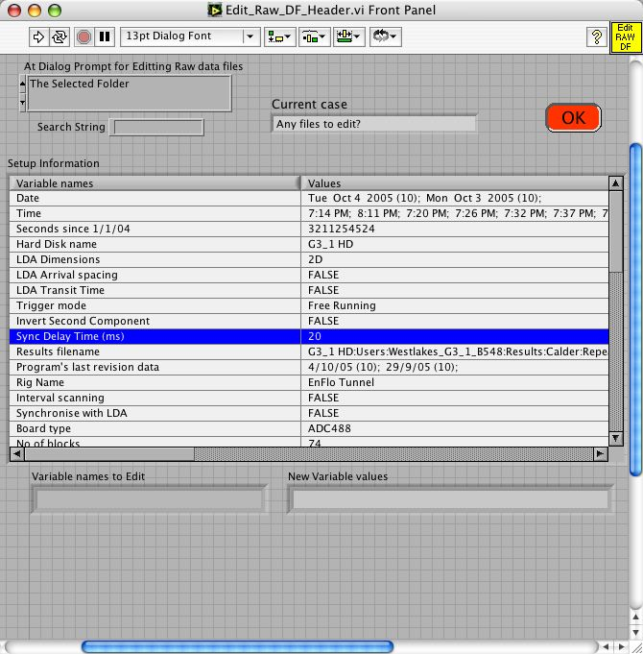
Changing Metadata in Raw data files

Slide 16
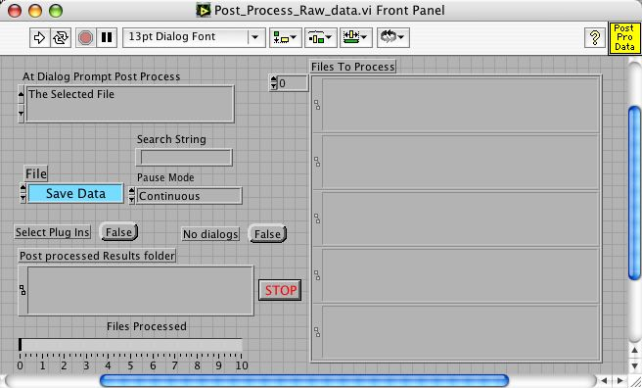
Post Process Profile

Slide 17
Current tips
EnFlo Tunnel can control Lab temperature
For FFID Need to purge lines before first calibration
Laser cooling water pump sometimes needs purging
Laser sometimes comes up with poor alignment
Don’t let Hydrosonic seeder water get slimy
If your getting FFID Calibration errors check gas pressures

Slide 18
Conclusion
Always calibrate before and after a measurement set
Check results sooner rather than latter
Don’t Just ignore error emails just because you do not understand them
Make sure you have looked at all the data before removing the setup from the tunnel
If you think there is something wrong with the code please tell me - Update software

